Slide 2
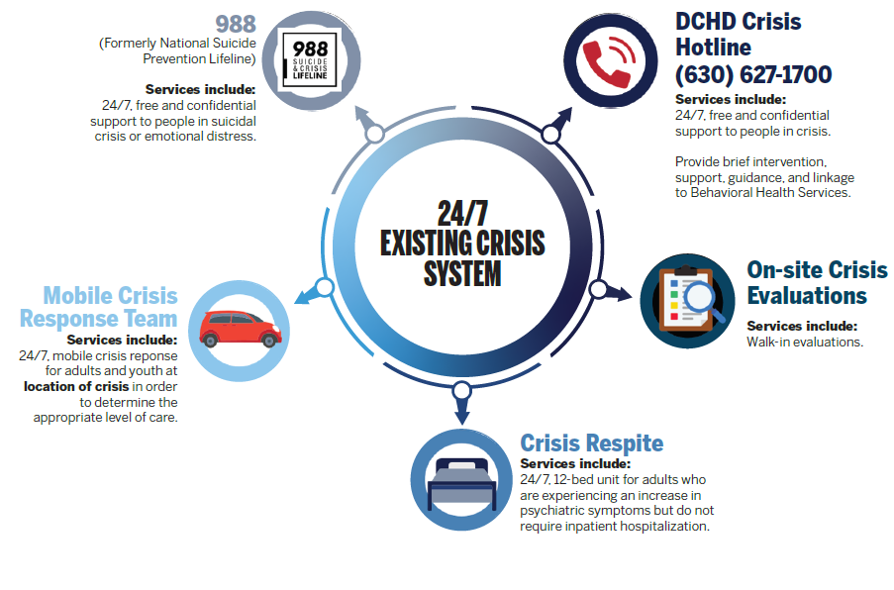
Notes:
988:
Highly trained crisis counselors answer the phone, listens to the caller, understands how their problem is affecting them, provides support, and shares resources if needed.
DCHD Crisis Hotline:
Highly trained counselors respond to those who may be experiencing a mental health crisis or need additional support
Crisis Respite:
Case management
Group and individual therapy
Integrated assessment and treatment planning
Psychiatric evaluation and medication management
Linkage to ongoing treatment
Crisis Staffing:
988 Call Center Specialists, FT Emergency Services Counselors, Engagement Specialists, On-call Emergency Services Counselors
Emergency Services Counselors:
Cross-trained to assist in all crisis services based on volume and need for the day.

Slide 4
The Crisis Recovery Center aims to transform DuPage County’s crisis response system by integrating national strategies and best practices.
This ensures more effective support for individuals facing mental health or substance use crises.

Slide 5
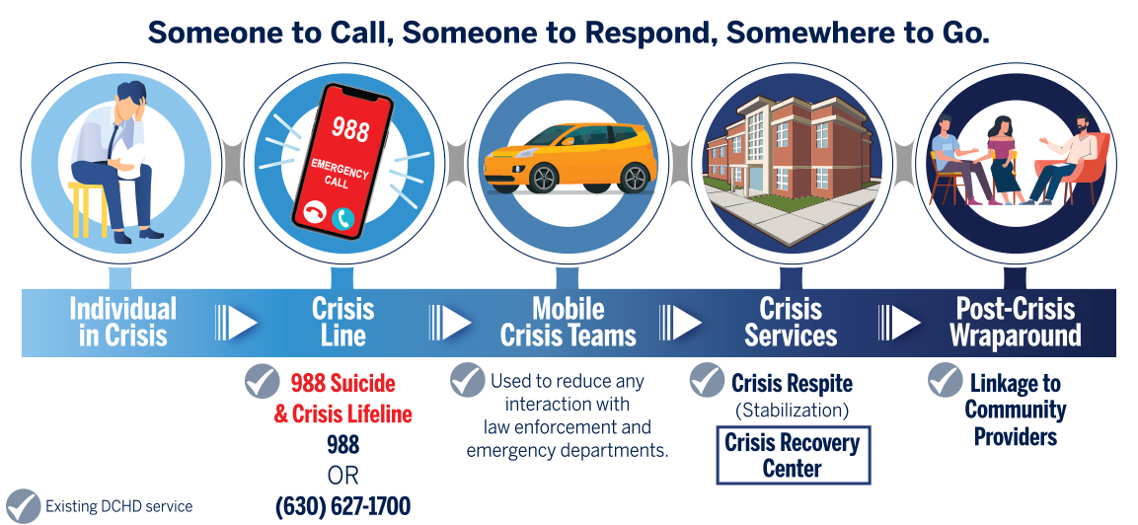
Notes:
This is a reflection of the national best practice model for our ideal system – the good news is we have already built several components of this ideal system as you can see here – we have many of the pieces checked off.
And now our primary focus shifts to the completion and development of this system by building the CRC. We are excited to partner with you on making this ideal system a reality for our residents.

Slide 6
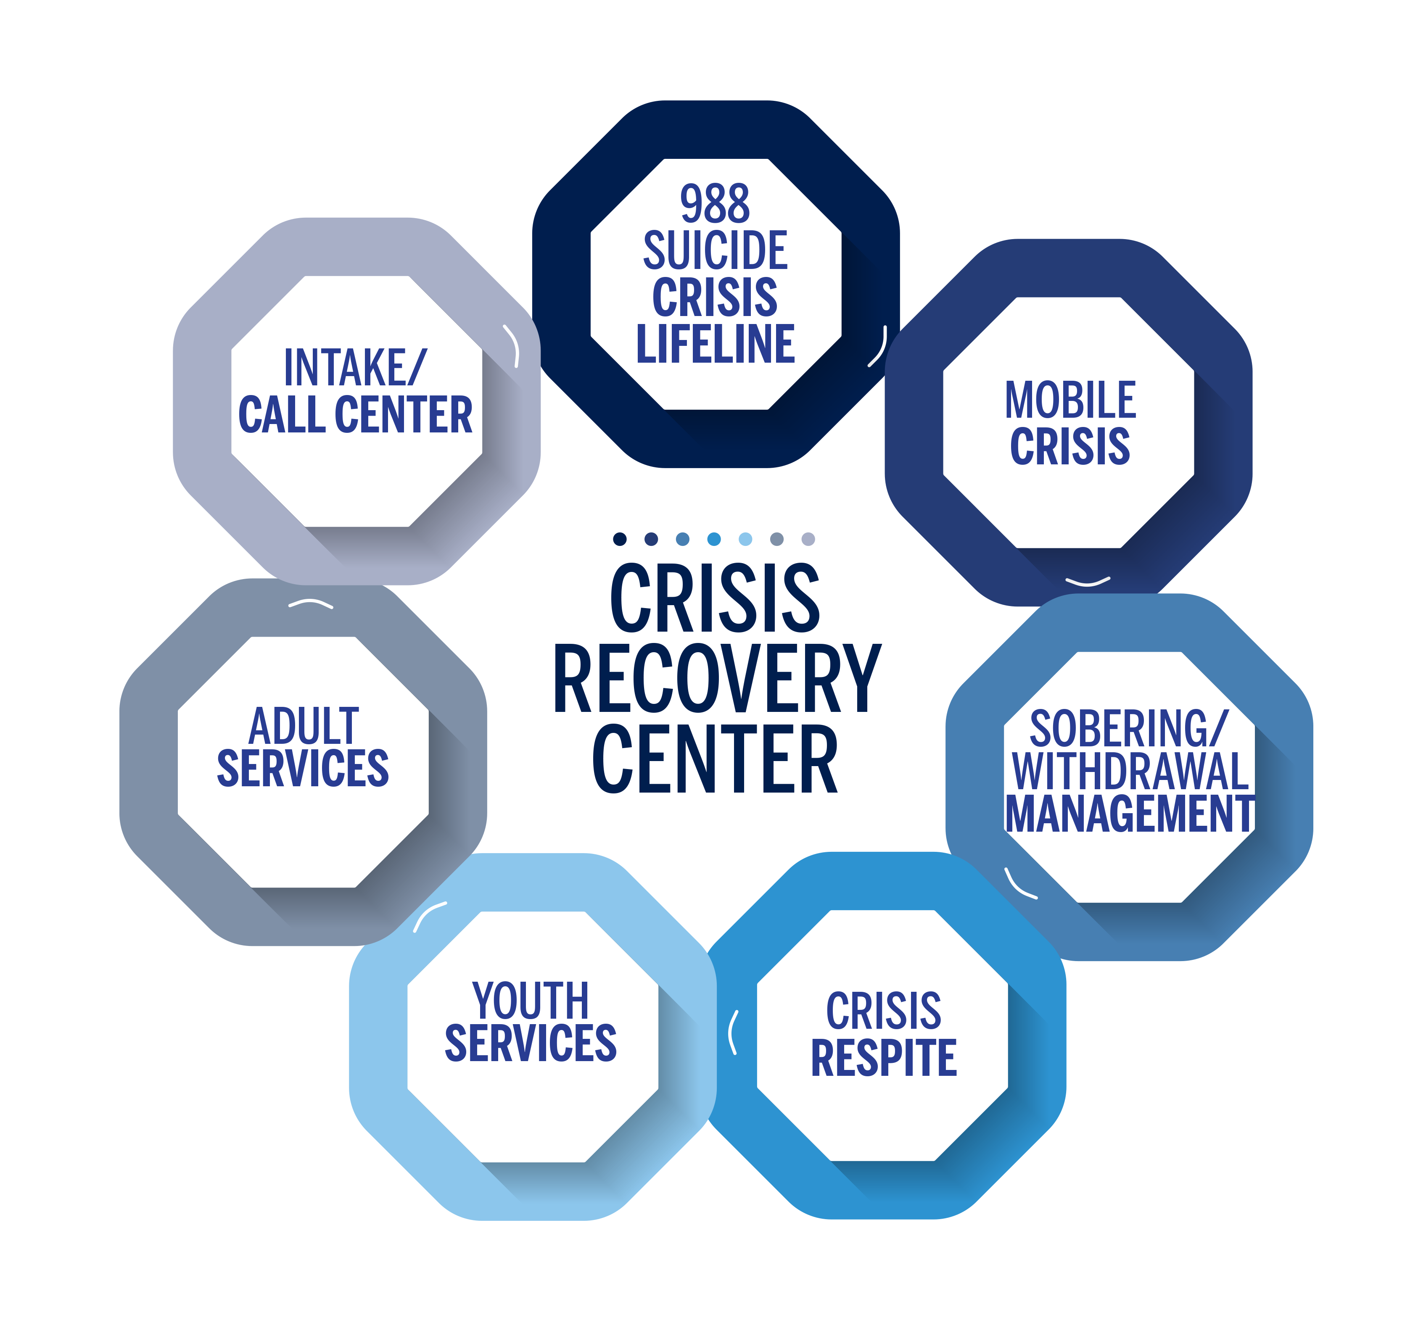

Slide 7
Building for Success- Goal of a Crisis Recovery Center
OUR NORTH STAR
optimal care for DuPage County residents experiencing a behavioral health crisis
Single point of access
Destigmatize
Safe alternative space
Sobering and non-medical withdrawal management
Reduce inappropriate utilization of ERs
Efficient and effective use of existing resources
Notes:
Provide a single point of access for individuals, family members, law enforcement officer and EMS to drop-off individuals experiencing a mental health or substance use crisis.
Destigmatize individuals with mental health and/or substance use disorders.
Provide a safe alternative space for individuals experiencing a mental health crisis.
Safe space for sobering and non-medical withdrawal management for individuals experiencing a substance use crisis.
Reduce the inappropriate utilization of hospital emergency departments
Provide an efficient and effective use of existing resources.

Slide 8
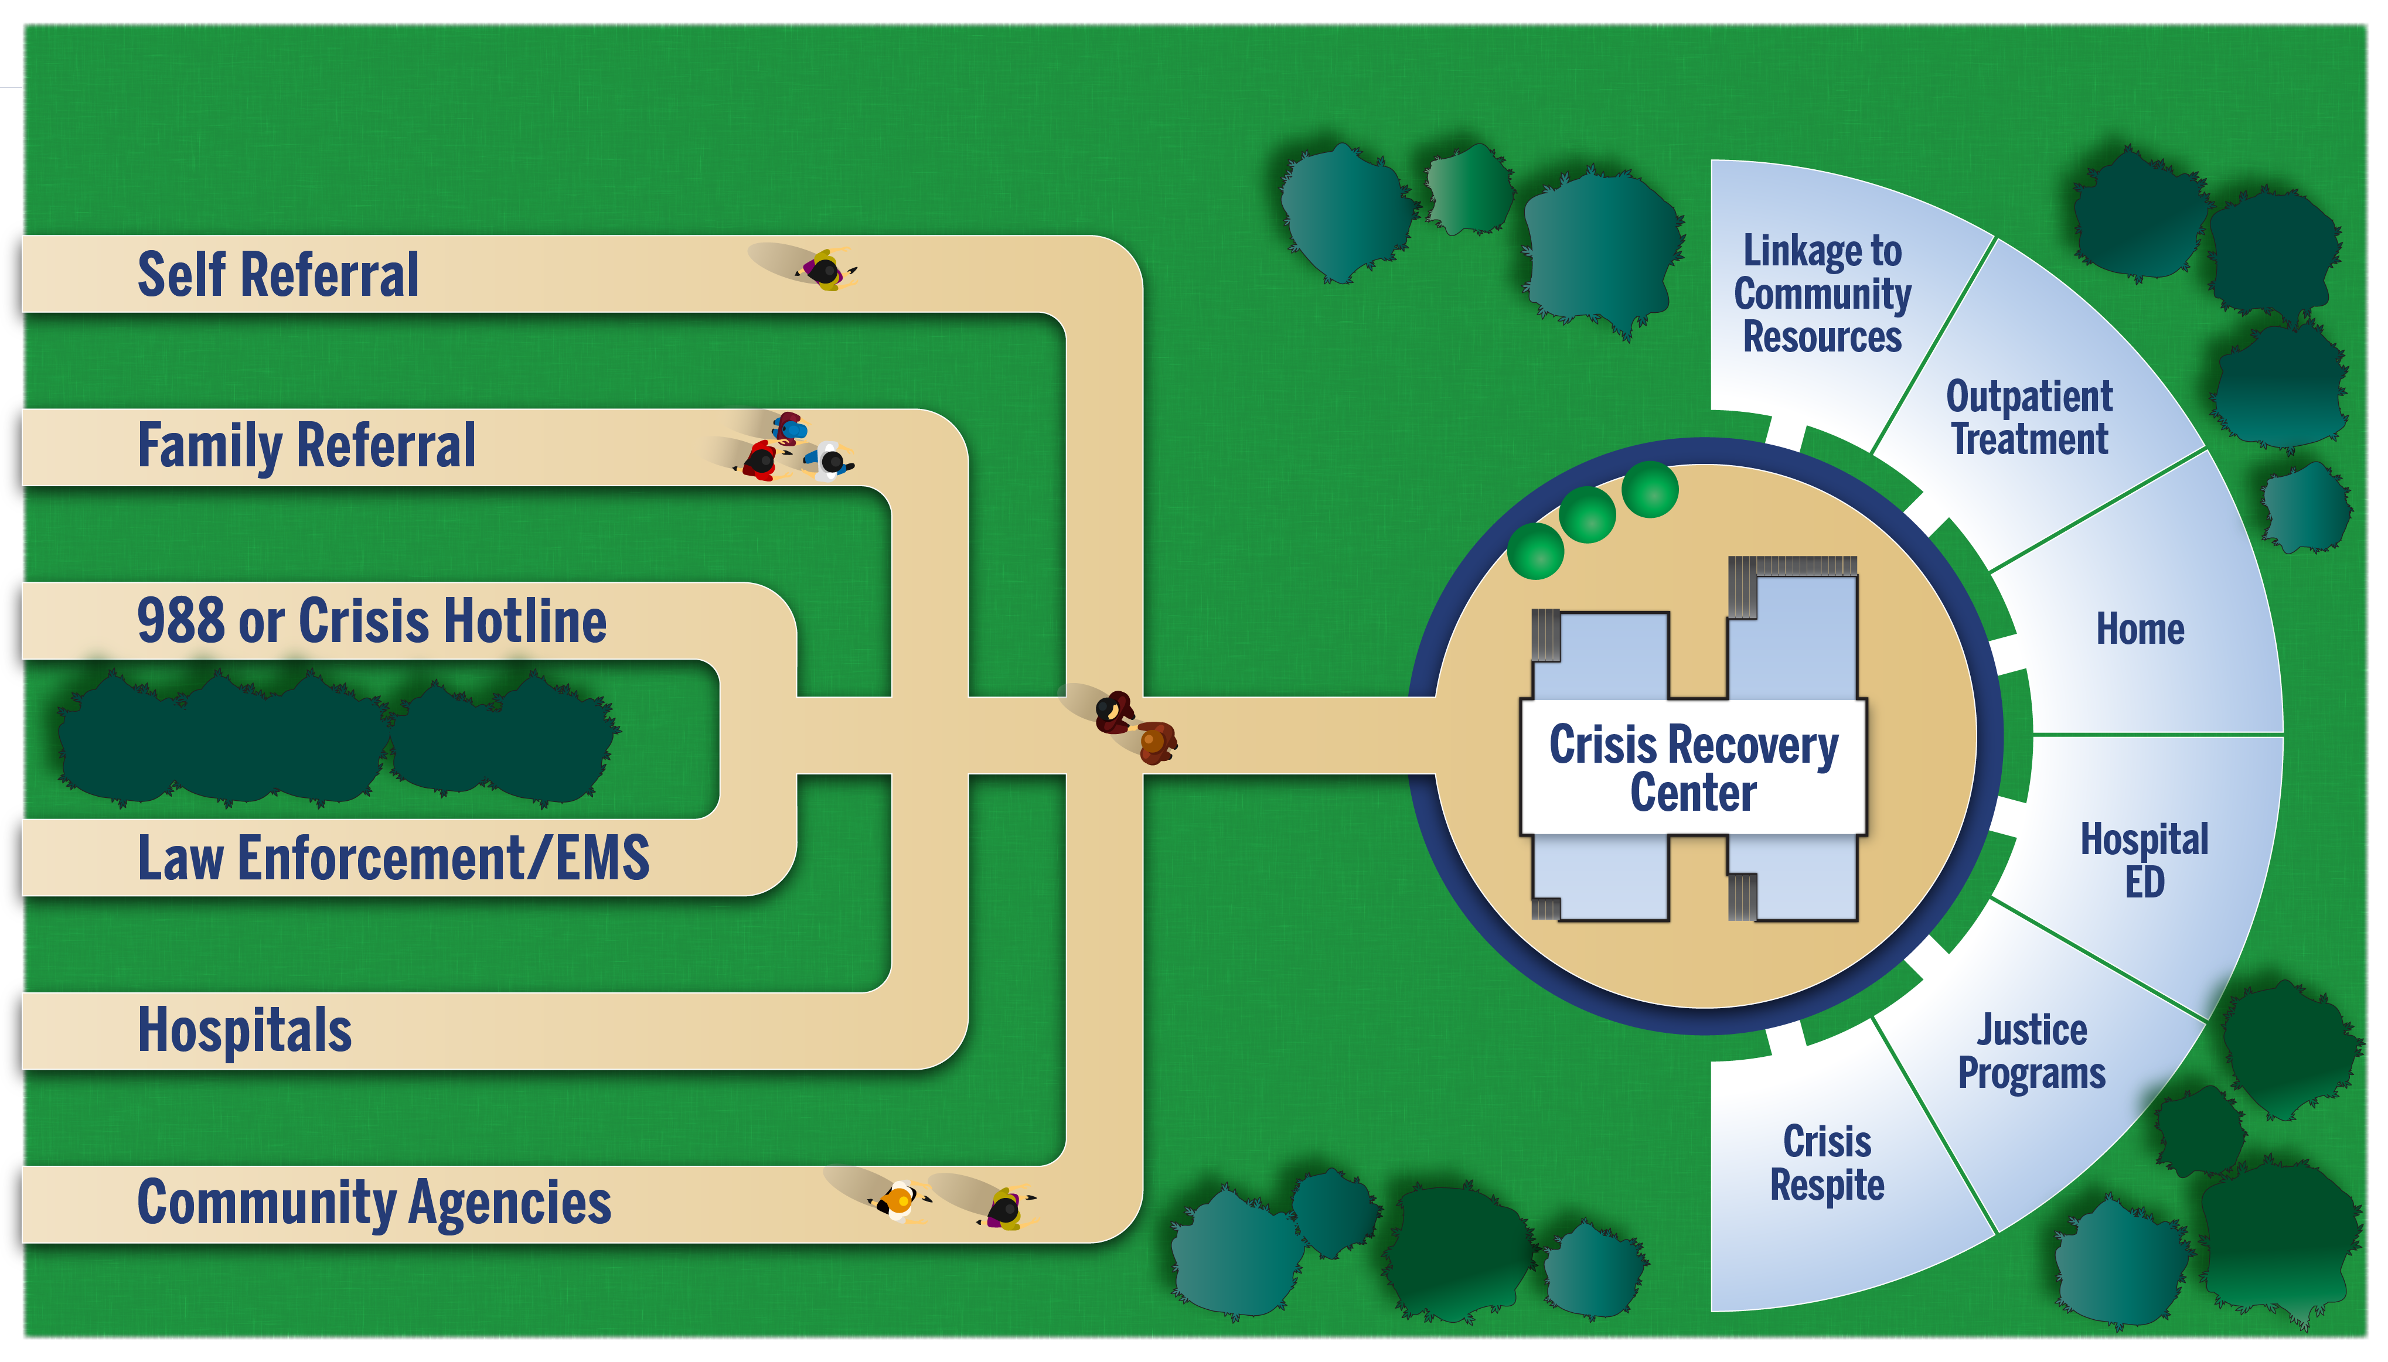
CRC Entry Points

Slide 9
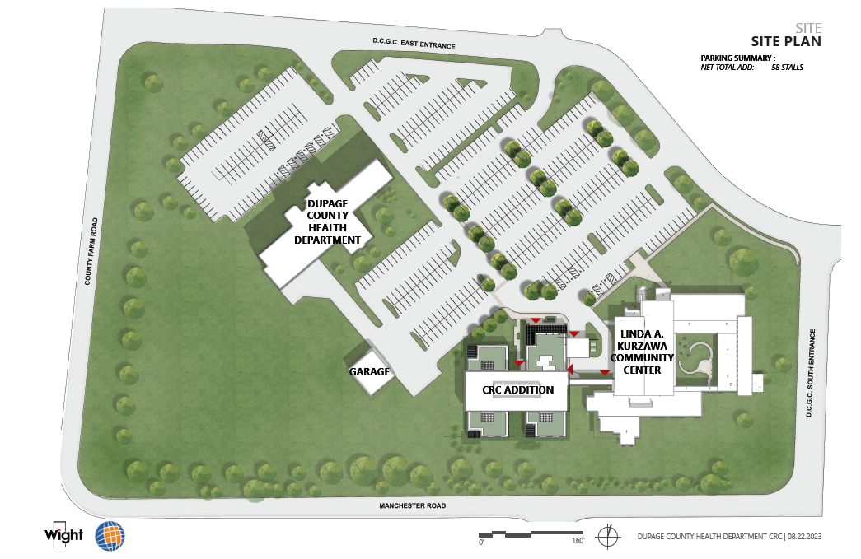

Slide 10
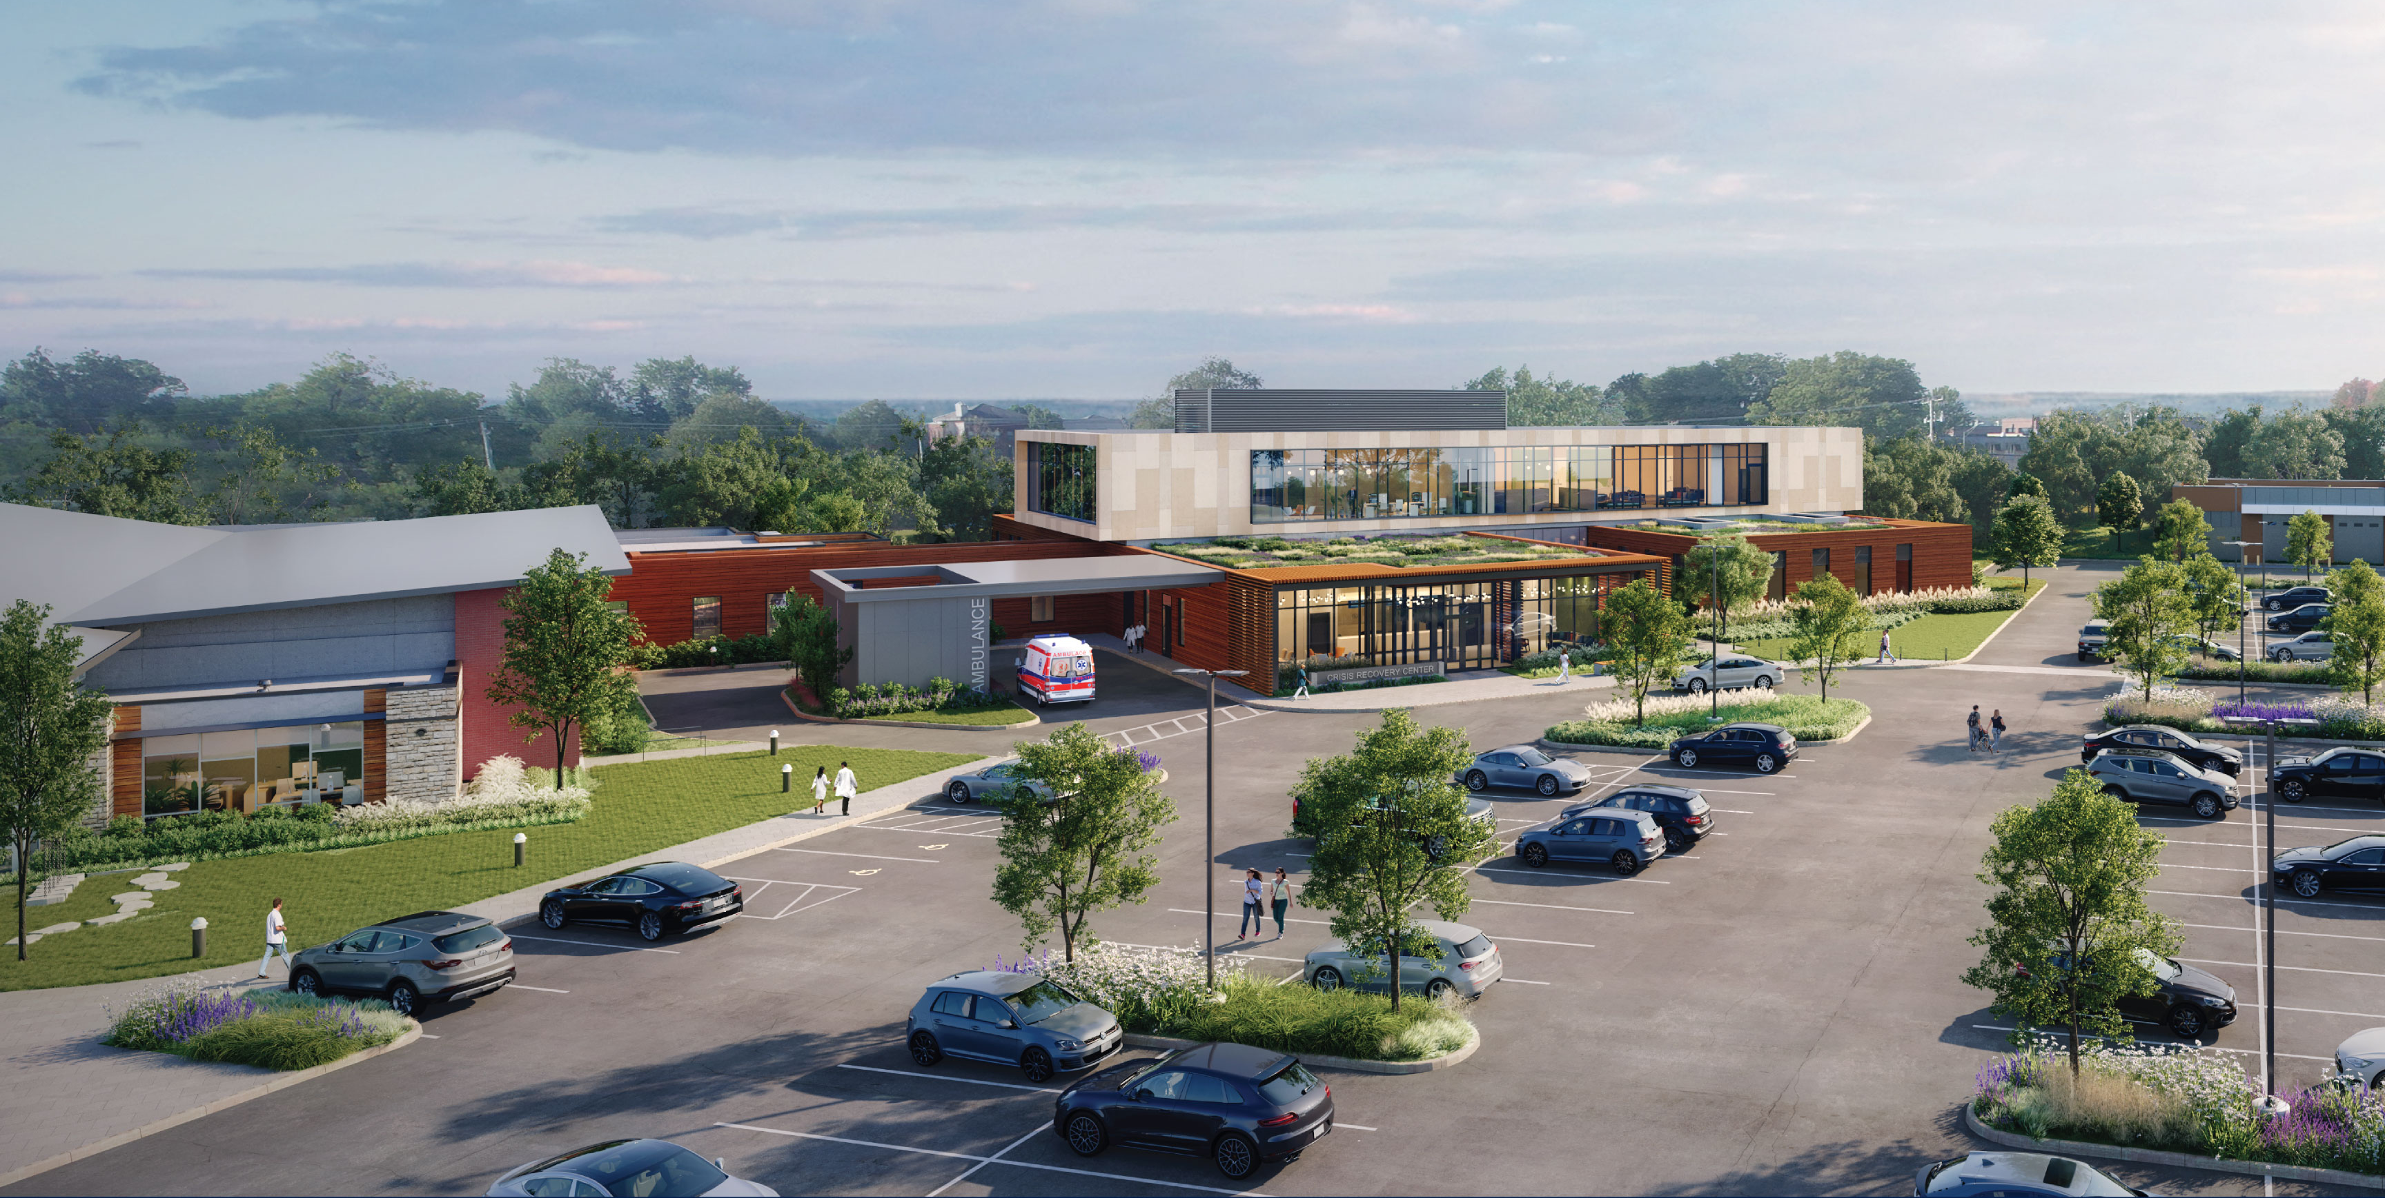

Slide 11
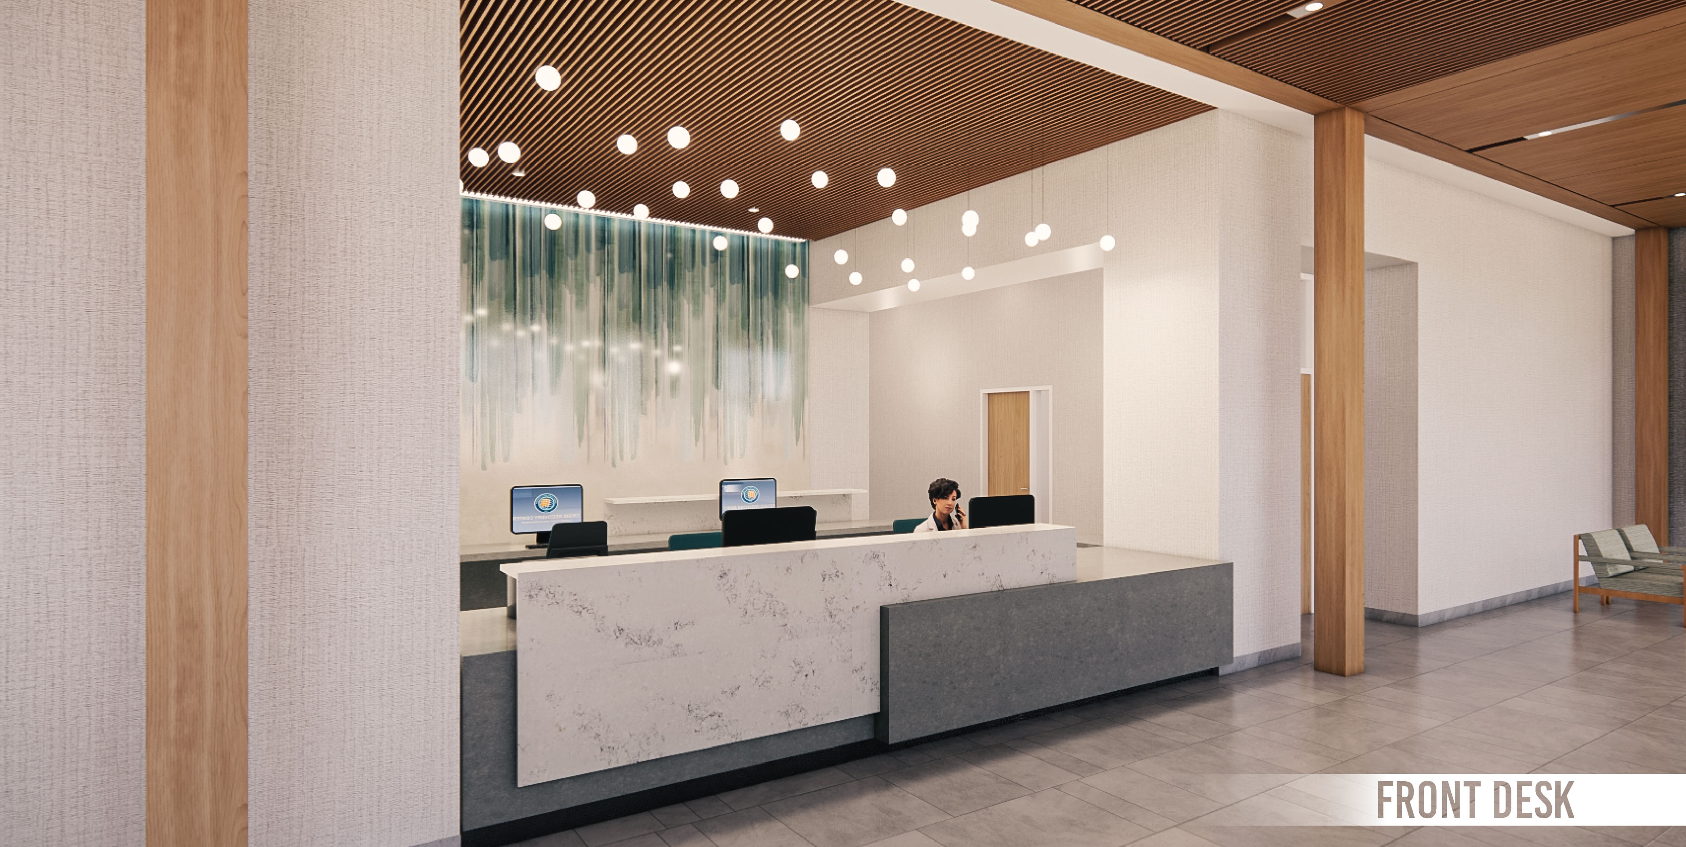

Slide 13
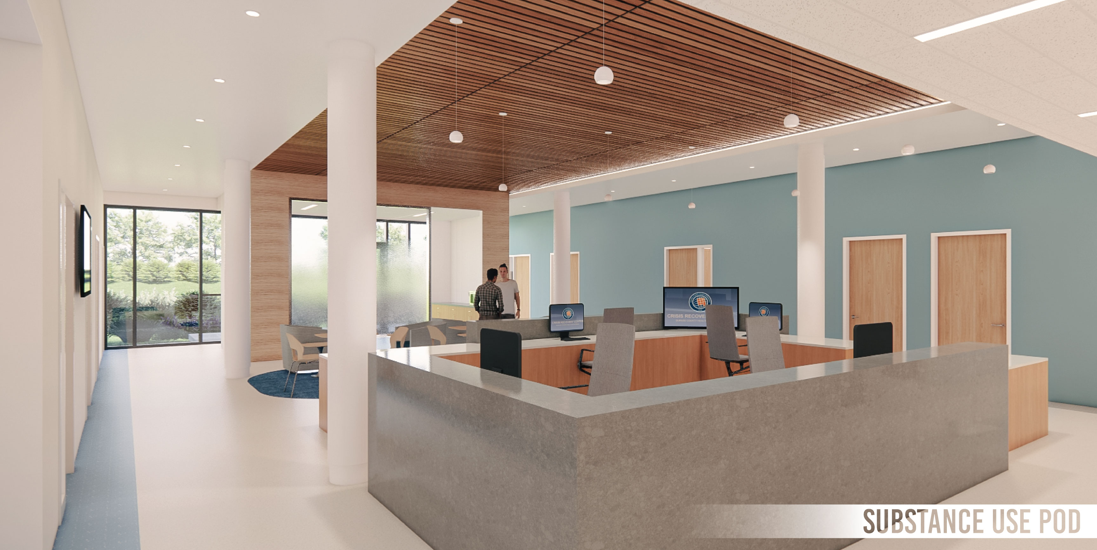

Slide 14
Key Takeaways
Crisis services available now.
The Crisis Recovery Center is one component
of crisis system expansion.
The Crisis Recovery Center leverages and builds upon the foundation of existing crisis services.
Customizing best practice models to fit the needs of DuPage residents.

Slide 15
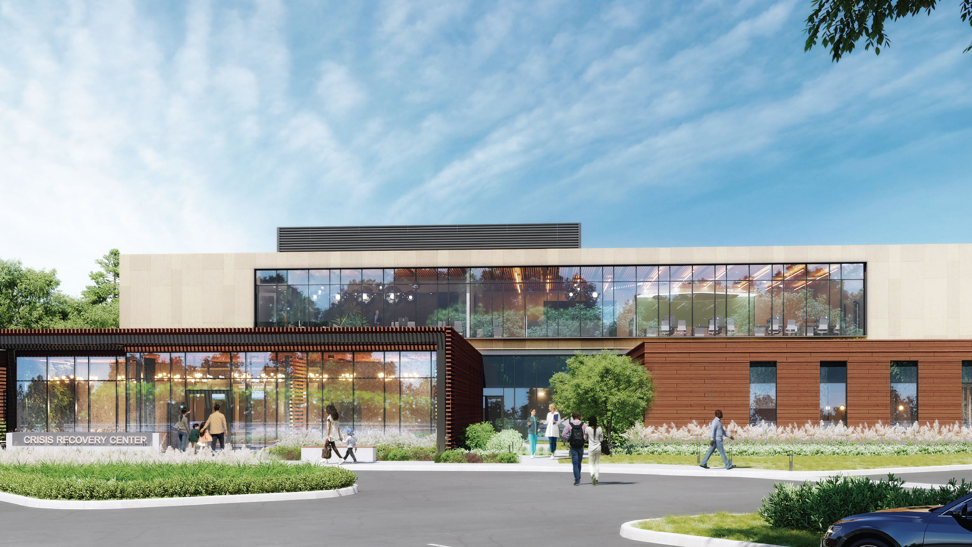

Slide 16
Questions?
Email us at:
CRC@dupagehealth.org

Slide 17
QUESTIONS
?

