Slide 1
Community Approach to Trespass and Suicide Prevention
October 24, 2024

Slide 2
Challenges for Trespass and Suicide Prevention
Trespass is the leading cause of death on U.S. rail, including suicide.
Many driving factors stem from larger societal issues that require collaboration with diverse partners.
City planning
Housing instability
Mental health concerns
Substance use
Lack of rail safety knowledge or vigilance around the track area
Language barriers
Equity considerations
A combination of approaches is often needed, making evaluation challenging.
There may be a lack of empirical knowledge about effectiveness.
Known mitigations may not translate the same way to all communities.
*This list is not exhaustive

Slide 3
Local Concerns Require Local Solutions
Each railroad faces a unique set of challenges.
Each community has unique needs.
Community-led efforts support a shared sense of responsibility.
3

Slide 4
National Strategy: Power of Community
2024 National Strategy for Suicide Prevention Strategic Direction 1: Community-Based Suicide Prevention
Goal 1: Establish effective, broad-based, collaborative, and sustainable suicide prevention partnerships.
Goal 2: Support upstream, comprehensive, community-based suicide prevention.
Goal 3: Reduce access to lethal means among people at risk of suicide.
U.S. Department Of Transportation Strategic Plan FY 2022-2026
Safety Strategies
Protect urban and rural communities and travelers, including vulnerable populations, from health and safety risks.
Equity Strategies
Empower communities through innovative public engagement with diverse stakeholders and thought leaders to foster exchange and ownership.
Ensure that equity considerations for disadvantaged and underserved communities are integrated into the planning, development, and implementation of all transportation investments.
4

Slide 5
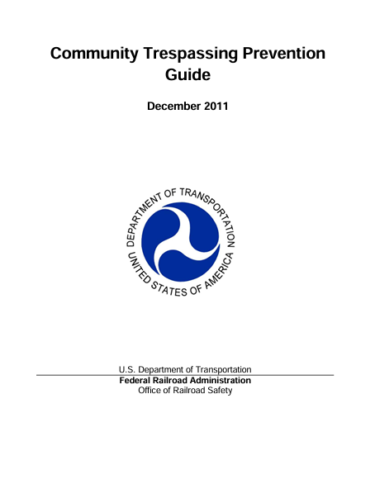
CARE Model
Community
Identify and engage with local stakeholders.
Analysis
Analyze data relevant to the problem.
Response
Identify appropriate actions and implement them.
Evaluation
Evaluate the effectiveness of the response.
5

Slide 6
Pilot Project
Collaborate with local community in Lake Worth Beach, FL.
Expand the CARE Model approach to include behavioral health and other social factors that contribute to risk.
Document the process and lessons learned.
Develop a community-based implementation guide.
6

Slide 7
CARE Approach
Current Status:
Identifying potential funding sources.
Engaging community members.
December 2023 April 2024 June 2024 TBD 2025
Community
Analysis
Response
Evaluation
Identify the problem.
Identify stakeholders.
Foster buy-in and engagement.
Identify relevant data sources.
Refine understanding of the problem.
Begin collecting baseline data.
Identify mitigation strategies.
Identify funding sources.
Engage additional stakeholders.
Begin implementation.
Identify measures.
Evaluate outcomes.
Document lessons learned.
7

Slide 8
Community: Diverse Stakeholder Group
Behavioral / Public Health
2-1-1 Florida
Southeast FL Behavioral Health Network
Health Care District of Palm Beach County
First Responders
Palm Beach Sheriff’s Office
Fire Rescue
Dispatch
Local Government
City officials
FL DOT
Rail / Transportation Safety
Federal Railroad Administration
Operation Lifesaver, Inc.
Volpe Center
Community Members
Guatemalan-Maya Center
Railroads
Brightline
Tri Rail
8

Slide 9
Analysis: Local Challenges
Shortcutting due to city planning
Language barriers
Equity challenges
Suicide
Encampments near the tracks
Continuing to learn about local risk factors
9

Slide 10
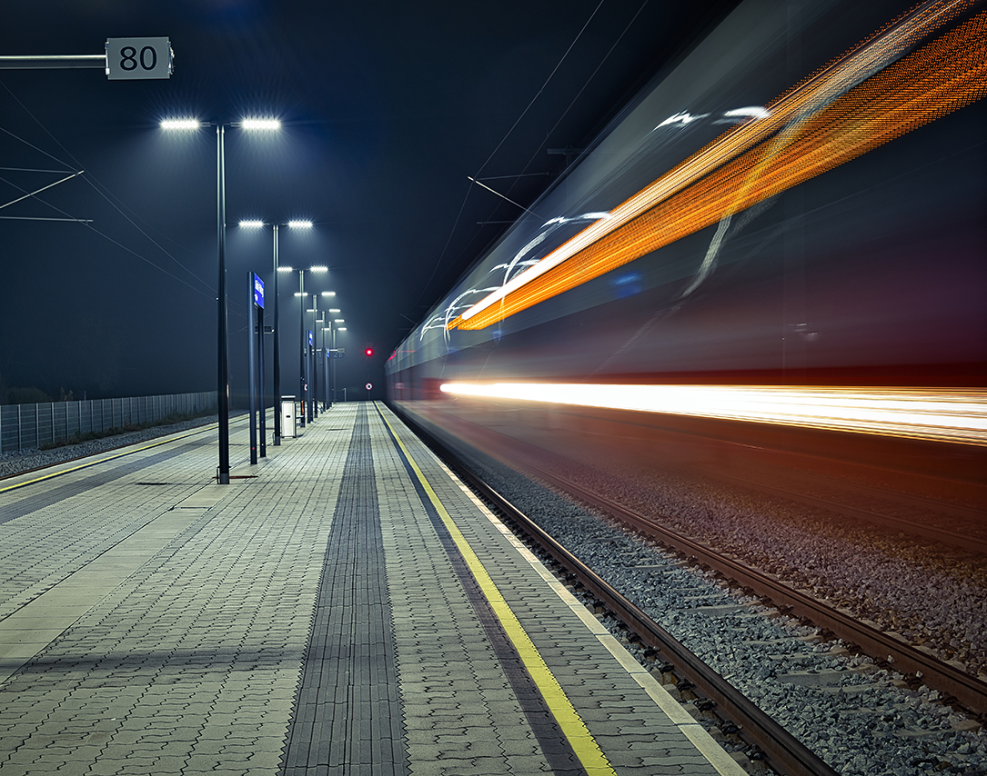
Response: Proposed Mitigations
Community outreach worker
Rail safety education
Physical barriers
Improving safer routes
2-1-1 and 988 signage
Crisis intervention training
Bystander education
10

Slide 11
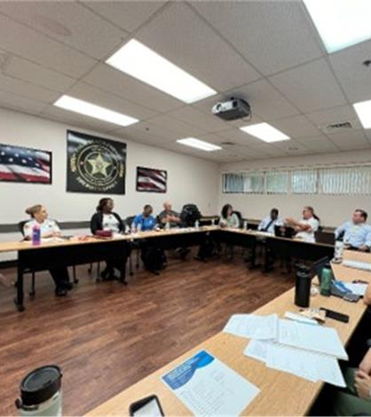
Bonus Benefits
Improved relationship between law enforcement and community members
Improved data collection for law enforcement
Improved communication between first responders and railroads
Emergency Notification System (ENS) sign information provided to dispatch
Expanded crisis intervention training for law enforcement, fire rescue, and railroad personnel
Crisis intervention teams extended to rail environment
11

Slide 12
Know The Warning Signs
Other Resources
www.take5tosavelives.org
www.afsp.org
www.sprc.org
www.988lifeline.org
What You Can Do
12

Slide 13
Questions?
Volpe Team:
Danielle Hiltunen
d.hiltunen@dot.gov
Scott Gabree, PhD
scott.gabree@dot.gov
Alexa D’Adamo
alexa.d’adamo@dot.gov
FRA Team:
Shala Blue, PhD
shala.blue@dot.gov
Michail Grizkewitsch
michail.grizkewitsch@dot.gov
Monica Shaw
monica.shaw@dot.gov

